Slide 1

A Project Presentation On Online Movie Ticket Booking System Submitted By Yashashwee Pradhan (41002191) A Project Presentation Submitted in partial fulfillment of the requirement of Bachelor of Computer Application (BCA) 4th Semester of Tribhuvan University, Nepal February, 2026

Slide 2
Table of Content
Introduction
Objectives
Scope
Functional Requirement
Feasibility Study
Methodology
System Design
Tools Used
Conclusion

Slide 3
Introduction
Online Movie Ticket Booking System is a web-based platform that allows users to browse available movies, check show-times, select seats, and book tickets online from anywhere without visiting the theater physically.
The system enables secure user authentication, online booking management, and provides an admin panel to manage movies, schedules, and booking records efficiently while ensuring a simple, reliable, and user-friendly experience.

Slide 4
Objectives
To develop a user-friendly online platform that allows users to browse movies, check showtimes, select seats, and book tickets securely and efficiently.
To automate the ticket booking process and provide an admin panel for managing movies, schedules, and bookings to improve overall operational efficiency.

Slide 5
Scope
This project provides a convenient and accessible platform for users to browse movies, check show timings, select seats, and book tickets online, reducing waiting time at theaters.
This project also enables administrators to manage movies, schedules, and bookings efficiently while generating reports for improved monitoring and business analysis.

Slide 6
Problem Statement
Traditional movie ticket booking takes a lot of time because people have to stand in long queues and visit the theater just to buy tickets.
There is no easy way to check movie times or seat availability in real time, which makes the process inconvenient for customers.
Managing bookings manually can lead to mistakes and poor record keeping, creating problems for theater management.

Slide 7
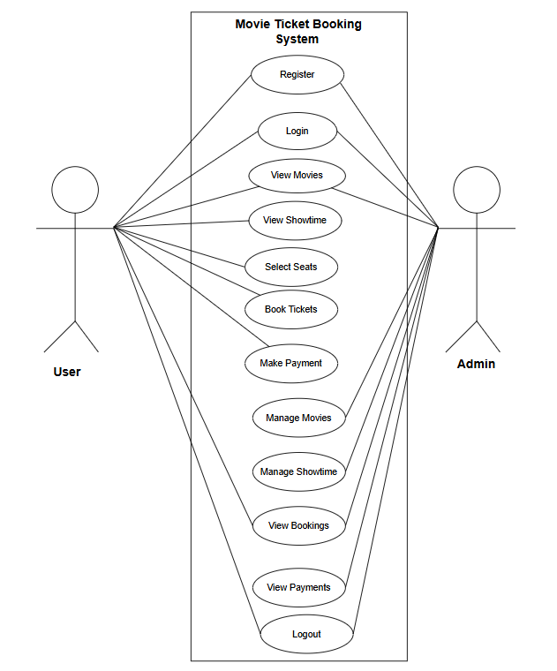
Functional Requirement

Slide 8
Feasibility Study
Technical Feasibility
Operational Feasibility
Economic Feasibility
Schedule Feasibility

Slide 9
Technical feasibility Study
The application is technically feasible as it is developed using widely available technologies like HTML, CSS, PHP, and MySQL, which are reliable, cost-effective, and well-supported.
The system can run on standard computers with basic hardware and software requirements, and the required technical skills for development and maintenance are easily accessible.

Slide 10
Operational feasibility Study
The Online Movie Ticket Booking System provides a simple and user-friendly interface, making it easy for customers to book tickets and for administrators to manage movies and schedules efficiently.
As an internet-based application, the system depends on stable connectivity, and temporary network issues may affect access or booking processes.

Slide 11
Economic feasibility Study
The main goal is to evaluate the cost and benefits of developing and maintaining the system.
The project requires minimal development and operational costs as it uses open-source technologies, and it helps reduce manpower expenses while increasing revenue through efficient online ticket sales.

Slide 12
Schedule Feasibility Study
It includes the project schedule and the time allocated for each phase of development and implementation.
The project is feasible within the given timeframe as proper planning, clear requirements, and a structured development approach ensure timely completion of all phases.
Gantt table and Gantt chart are below:

Slide 13
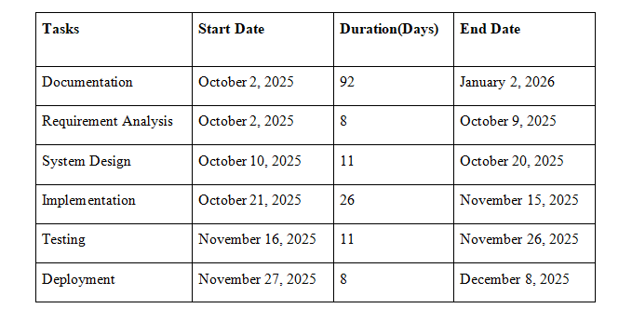
Gantt table

Slide 14
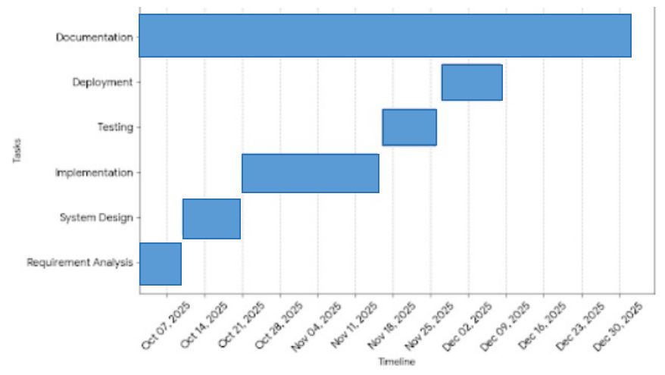
Gantt Chart

Slide 15
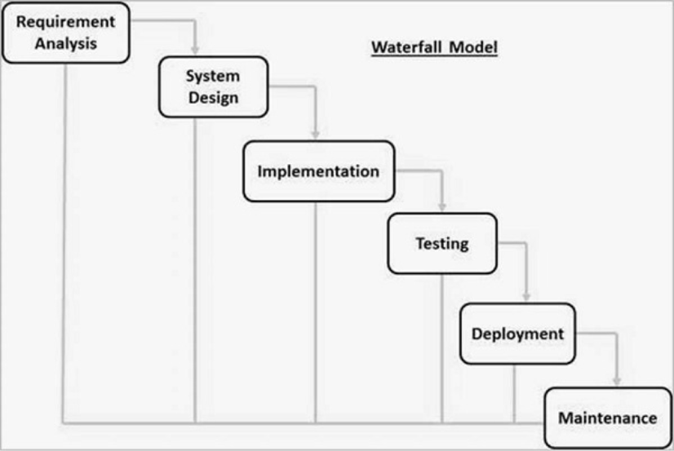
Methodology

Slide 16
System Design
ER Diagram
Level 0 DFD
Level 1 DFD
System Architecture
Database Schema Design
Interface Design
Physical DFD Design

Slide 17
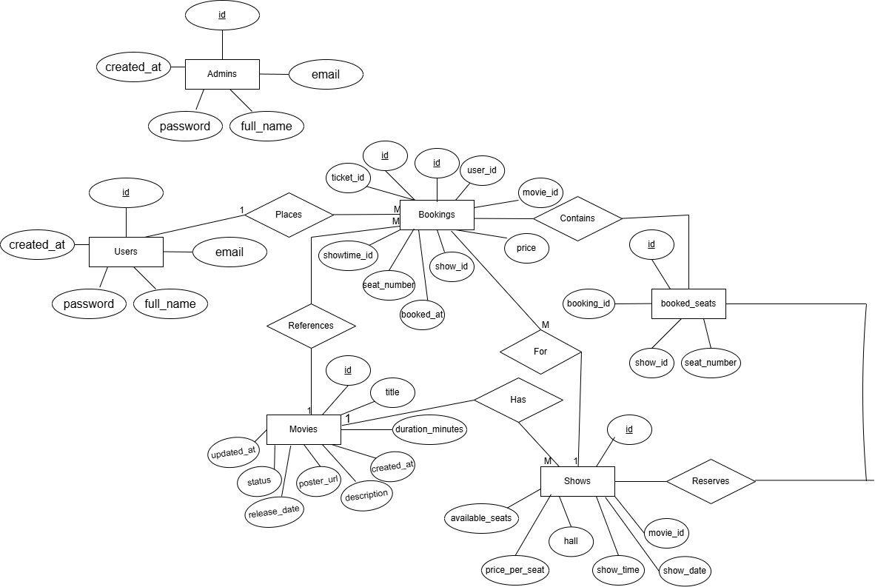
ER Diagram

Slide 18
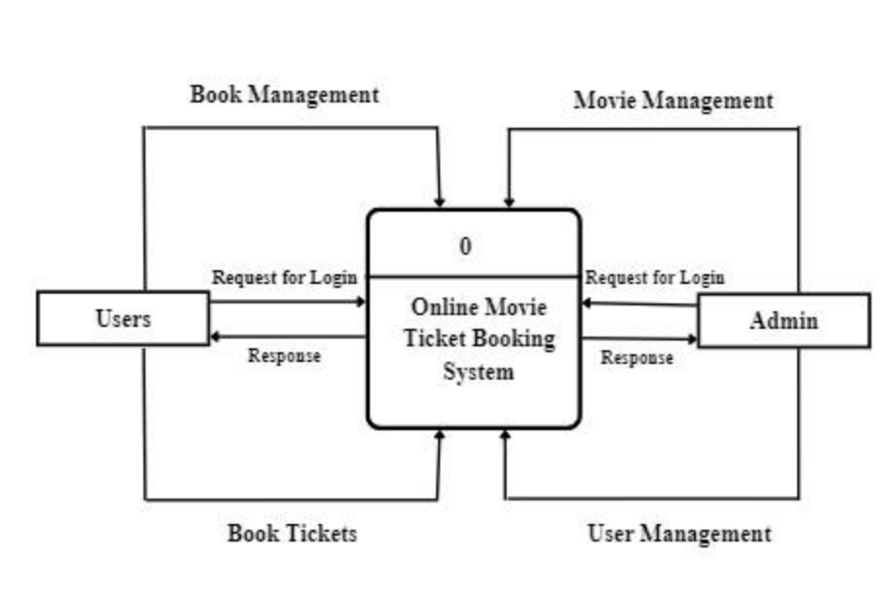
Level 0 DFD

Slide 19
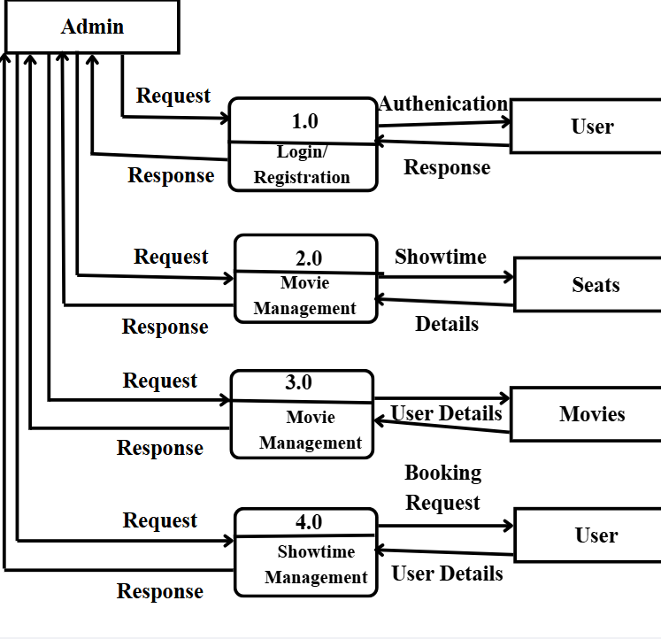
Level 1 DFD

Slide 20
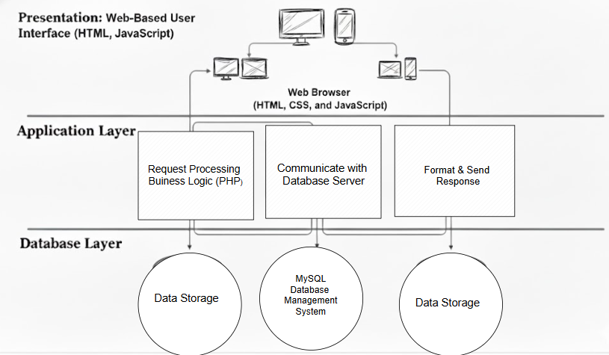
System Architecture

Slide 21
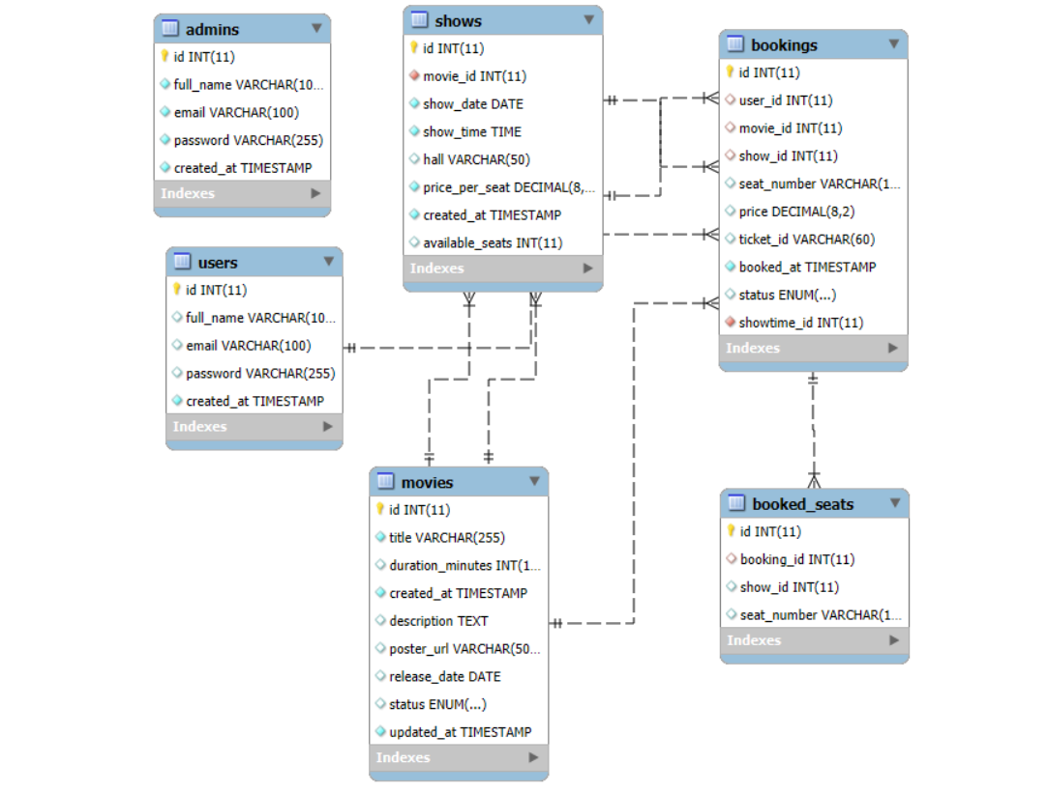
Database Schema Design

Slide 22
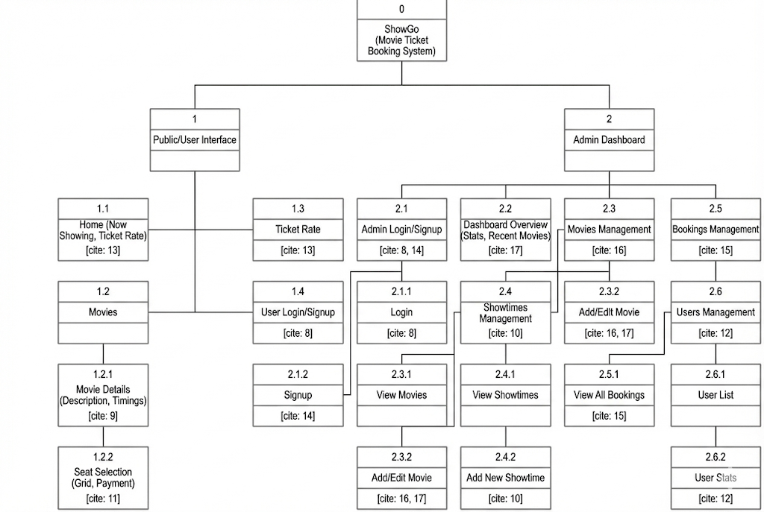
Interface Design

Slide 23
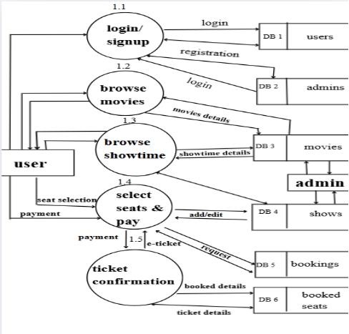
Physical DFD Design

Slide 24
Tools Used
Software tools
Html
CSS
JavaScript
PHP
MySQL

Slide 25
User Module
S.N | Action | Input | Expected Outcome | Actual Outcome | Test Result
1 | Verify user login with valid creditals | Valid email and password | User logged in successfully | User logged in successfully | Pass
2 | Verify user login with invalid credentials | Invalid email and password | Error message displayed | Displayed error message | Pass
3 | Verify user registration | Valid user details | Account created successfully | Account created successfully | Pass
4 | View booking history | User dashboard request | Booking history displayed | Booking history displayed | Pass

Slide 26
Features Module
S.N | Action | Input | Expected Outcome | Actual Outcome | Test Result
1 | Display available movies | Load movie list page | Movie and show timing displayed | Shows available movies posters with show timing | Pass
2 | Verify seat selection | Select available seats | Seat selected successfully | Can select available seats | Pass
3 | Prevent booking of booked seats | Select unavailable seats | Seat selection denied | Unavailable seats are red in color | Pass
4 | Confirm ticket booking | Movie show, seat selected | Booking confirmed | Proceeds to confirmation of payment | Pass
5 | Display ticket receipt after payment | Click confirm payment | Show receipt | After payment, receipt displayed | Pass

Slide 27
User Interface
S.N | Action | Input | Expected Outcome | Actual Outcome | Test Results
1 | Verify form validation | Submit empty fields | Validation message displayed | Throws validation message | Pass
2 | Verify navigation links | Click menu links | Correct page loaded | Loads correct pages | Pass
3 | Check button responsiveness | Clicking booking button | Correct action performed | Booking confirmed after payment | Pass
4 | Check mobile responsiveness | Resize screen | Layout adjusts properly | Can adjust according to screen sizes | Pass

Slide 28
Admin Interface
S.N | Action | Input | Expected Outcome | Actual Outcome | Test Results
1 | Admin login verification | Valid admin creditals | Admin logged in successfully | Verified admin logged in successfully | Pass
2 | Add movie details | New movie information | Movie added successfully | Movie details and poster added successfully | Pass
3 | Update movie details | Modified movie information | Movie updated successfully | Modify movie details and posters successfully | Pass

Slide 29
S.N | Action | Input | Expected Outcome | Actual Outcome | Test Results
4 | Delete movie | Select movie to delete | Movie deleted successfully | Deletes movie details and poster successfully | Pass
5 | Manage user accounts | Update/delete user | Changes saved successfully | Displays user details | Pass
6 | View booking reports | Report request | Booking report displayed | Shows revenue | Pass

Slide 30
Conclusion
In conclusion, the project “Online Movie Ticket Booking System” successfully provides a simple and convenient platform for users to browse movies, check showtimes, select seats, and book tickets online.
By implementing fundamental web technologies, the system ensures efficient management of movies, schedules, and bookings while offering opportunities for future improvements in performance, usability, and additional features.

Slide 31
DEMO

